Slide 1
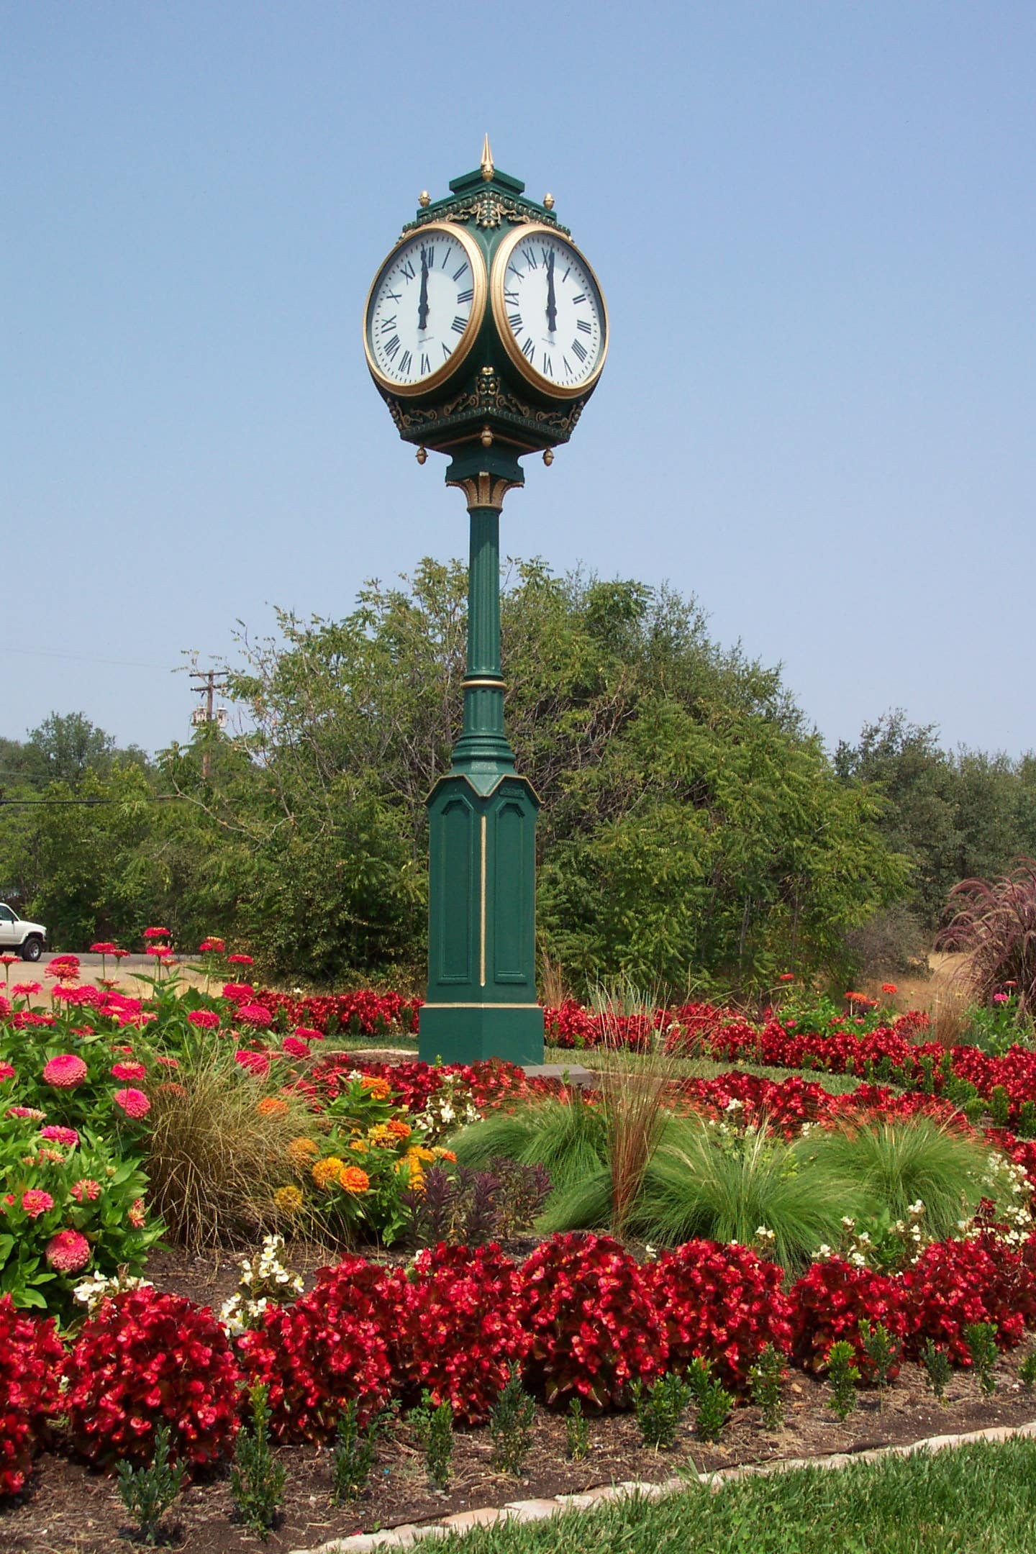

2021 America Rescue Plan Act (ARPA) Funding City of Shasta Lake
City Council Meeting
August 17, 2021
Jessaca Lugo, City Manager

Slide 2
Background
American Rescue Plan signed by President Biden on 3/11/2021
$1.9 Trillion aid package that provides financial aid to families, governments, businesses, schools, non-profits & others impacted by COVID-19 public health crisis, including:
$656 Billion for Direct Financial Assistance (Stimulus checks $1,400; expanded and extended unemployment; tax credits; Paycheck Protection Program PPP; EIDL program, community and economic development, grants to small businesses, etc.)
$56 Billion Assistance to Individuals and Families (SNAP; WIC; EBT; Nutrition assistance; Veterans Affairs; Family Violence Prevention; IDEA; Child Abuse prevention; Emergency assistance; OAA; Elder justice act; etc.)
$211 Billion for Education and Childcare (8 program areas)
$86 Billion for Health (22 program areas)
$40 Billion for Transportation (Transit; Airports; Amtrak)
$61 Billion for other (11 program areas)
$350 Billion for State and Local governments Fiscal Recovery Fund

Slide 3
Background
$350B State and Local Aid; $65.1B to Cities, $65.1B to
Counties
Funding Estimates largely based on population:
State of CA | City of Shasta Lake | City of Redding | City of Anderson | County of Shasta
$26.0 B | $2,491,011 | $18,693,433 | $2,542,922 | $35,000,000

Slide 4
City of Shasta Lake ARPA Allocation
Final ARPA Funding Allocation: $2,491,011
Traunch 1: $1,245,505 (received 07/14/2021)
Traunch 2: $1,245,506 (to be disbursed one year est. 7/2022)
Treasury is interpreting the requirement that costs be incurred by December 31, 2024, to only require that recipients have obligated the funds by such date. Unexpended funds must be returned to treasury.
The period of performance will run until December 31, 2026, which will provide recipients a reasonable amount of time to complete projects funded with Fiscal Recovery Funds.
Local governments are required to provide “periodic reports” providing a detailed accounting of the use of funds

Slide 5
State and Local Fiscal Recovery Fund: Use of funds (Four Categories)
To respond to the public health emergency or its negative economic impacts, including assistance to household, small businesses, and nonprofits, or aid to impacted industries such as tourism, travel, and hospitality;
To respond to workers performing essential work during the COVID-19 public health emergency by providing premium pay to eligible workers;
For the provision of government services to the extent of the reduction in revenue due to the COVID-19 public health emergency relative to revenues collected in the most recent full fiscal year prior to the emergency; and
To make necessary investments in water, sewer, or broadband infrastructure

Slide 6
a) To respond to the public health emergency or its negative economic impacts, including assistance to household, small businesses, and nonprofits, or aid to impacted industries such as tourism, travel, and hospitality;
Supporting Public Health Response by:
Services to contain and mitigate the spread of COVID-19
Behavioral healthcare services, including mental health or substance misuse treatment, etc.
Address the Negative Economic Impacts by:
Delivering assistance households
Support for small business and nonprofits
Build stronger neighborhoods and communities with projects or programs
Speed the recovery of impacted industries such as Tourism, Travel, and Hospitality sectors

Slide 7
b) To respond to workers performing essential work during the COVID-19 public health emergency by providing premium pay to eligible workers;
Offering additional support to those who have and will bear the greatest health risks because of their service in critical infrastructure sectors
Limitations: amount not to exceed $25,000 per worker
Designed for low-income earners providing essential work during pandemic
Additional documentation necessary if pay exceeds 150% of average wages

Slide 8
c) For the provision of government services to the extent of the reduction in revenue due to the COVID-19 public health emergency relative to revenues collected in the most recent full fiscal year prior to the emergency; and
Recipients may use these funds to replace lost revenue
Treasury Department has specific methodology to calculate lost revenue
Once shortfall is identified, Cities will have broad latitude to use this funding to support government services
Note: Per the ARPA Public Revenue Loss Calculator for California Cities, The City of Shasta Lake is on track with our revenues, and do not have a significant loss.

Slide 9
d) To make necessary investments in water, sewer, or broadband infrastructure
Make necessary investments to improve access to clean drinking water, support vital wastewater and stormwater infrastructure, and to expand access to broadband internet

Slide 10
Fiscal Recovery Funds: Ineligible Uses
To offset a reduction in taxes
Deposits into a pension fund
Funding debt service
Funding legal settlements or judgements
Deposits into a rainy-day fund or financial reserves

Slide 11
Principles to consider for use of ARPA for local fiscal recovery
Use Dedicated grants and programs first whenever possible
Save Local Fiscal Recovery Funds for gaps and priorities not eligible for other federal and state assistance programs
Use Revenue Loss funding category last for priorities not eligible either with federal or state grants or other Local Fiscal Recovery Fund categories
Assess government operations and community needs
Look for areas where funding has not been possible previously
Transformative and catalytic community projects with broad public need and support
Projects/programs in partnership with Shasta County or other partners
Use existing programs and partnerships already established
Tapping into State Fiscal Recovery Funds
There may also be remaining CARES funds (must be spent by 12/31/21)
Use this one-time funding for one-time expenses
Analyze fit with City Council Priorities

Slide 12
Considerations
Finance Department has completed the revenue loss calculator. Does not see any significant loss of revenue. Note: 2021 Audit has not been complete.
Currently meeting with City of Redding on stakeholder outreach (coordination with County will also be included)
City Finance Committee has reviewed the ARPA program and expected funding.
Timing (deadlines for spending or encumbering)

Slide 13
Process
Determine process:
City Council as a Whole to determine plan? and/or
Refer to City Council Finance Committee? and/or
Other (Ad hoc, citizen committee)
Identify priorities and/or funding by category
Evaluate readiness, confirm costs and timelines
Public Engagement Process
City Council Final Approval to allocate funds

Slide 14
Current/Previous COVID-19 Recovery Assistance
Grant No. | Funding Amount | Program | Status
20-CDBG-CV1-00021 | $ 85,600.00 | Utility Payment Program | 100% Expended
20-CDBG-CV1-TBD | $ 311,498.00 | Utility Payment Program | Contract Pending 50% expended
20-CDBG-CV1-00102 | $ 62,000.00 | Microenterprise Program | 57% expended
2021 CDBG CV2/3 Tribal | $ 200,000.00 | Food Bank | Waiting on Contract from State
2021 CDBG CV2/3 Tribal | $ 200,000.00 | Youth Programs | Waiting on Contract from State
2021 CDBG CV2/3 Tribal | $ 200,000.00 | Elders Nutrition | Waiting on Contract from State
2021 CDBG CV2/3 Tribal | $ 100,000.00 | Rapid COVID Testing | Waiting on Contract from State

Slide 15
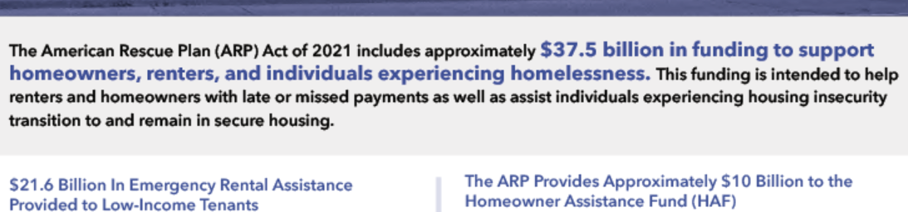
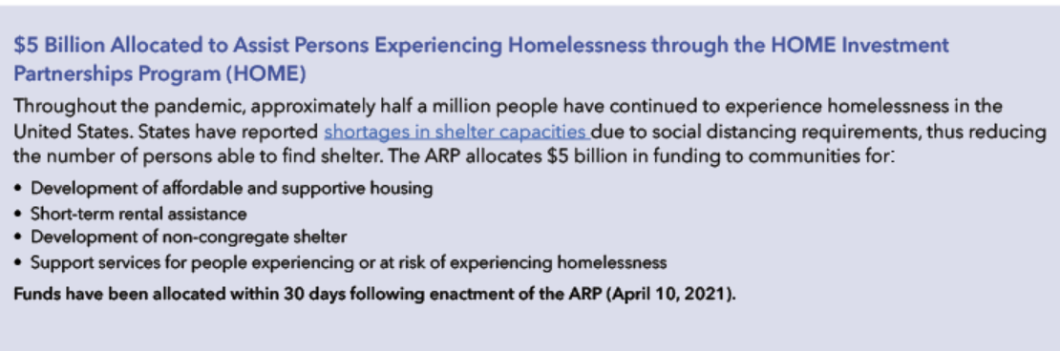
Federal Housing Assistance via ARPA

Slide 16

QUESTIONS

